Slide 1
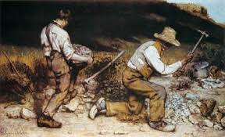
On Liberty

Slide 2
Its Importance?
What is liberty?
Liberty rests on certain values.
Mill seeks to protect the individual.
Tyranny of the State
Power of the Elite
Tyranny of Public Opinion

Slide 3
The Harm Principle
The harm principle protects the individual from harm.
The harm principle is opposed to --
Legal Paternalism
Legal Moralism
Offense

Slide 4
When we look at all kinds of human action they can be put into two categories.
Self-regarding actions
Other-regarding actions
The sphere of other regarding behavior is where it is legitimate but not wise to use the law.

Slide 5
There are two types of other regarding cases.
My actions harm others.
My inactions harm others.

Slide 6
Mill places a high value on liberty.
Liberty of action versus liberty of thought.
Mill gives an argument for freedom of speech that has become famous.
What happens if we oppress opinion and its true?
Suppose a view is possibly false?
Suppose a view is totally false?

Slide 7
Truth and reason have a utilitarian payoff. The greatest happiness of the greatest number is seen by the survival of the most true. The most true survives in an open society – a society that affords the individual the framework to seek his or her good. So On Liberty and Utilitarianism come together.

